Slide 1
DIGITAL IMAGE PROCESSING- IOE 412
ATTENDANCE SYSTEM USING FACE RECOGNITION – Mini Project
Done By: Vishnu Anilkumar 2022BEC0001
Swaminathan PL 2022BEC0002
Nishanth Raghu 2022BEC0003
Jaganath Krishnan 2022BEC0004
Datta Sivasai 2022BEC0005

Slide 2
Project Overview
Problem: Manual attendance is time consuming, error-prone and contact-heavy.
Solution: Build a contactless attendance system that detects faces in an uploaded photo, recognizes enrolled students, marks attendance automatically and stores logs.
Benefits:
Saves time
Reduces errors
Contactless and scalable

Slide 3
Workflow
Step 1 — Pre-processing:
Convert input image from BGR → RGB
Resize image for faster detection
Optionally apply histogram equalization / noise removal
Intermediate Result: Preprocessed image shown before segmentation
Step 2 — Segmentation (Face Detection):
Use HOG/CNN model from face recognition to locate faces.
Draw bounding boxes around detected faces
Intermediate Result: Image with detected face boxes labeled as Detected Regions
Step 3 — Feature Extraction:
Generate 128-D face embedding for each detected face
Intermediate Output: Display first few embedding vectors
Step 4 — ML-Based Modelling (Recognition):
Compare extracted features to stored encodings via Euclidean distance
Label as Known if below threshold, else Unknown
Intermediate Result: Image annotated with labels before saving final results
Step 5 — Post-processing:
Save recognized faces
Save unknown faces
Update the csv file

Slide 4
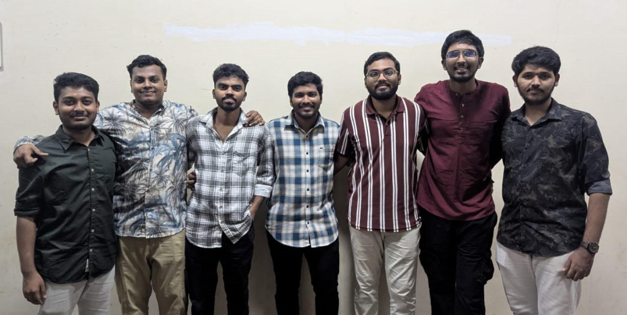
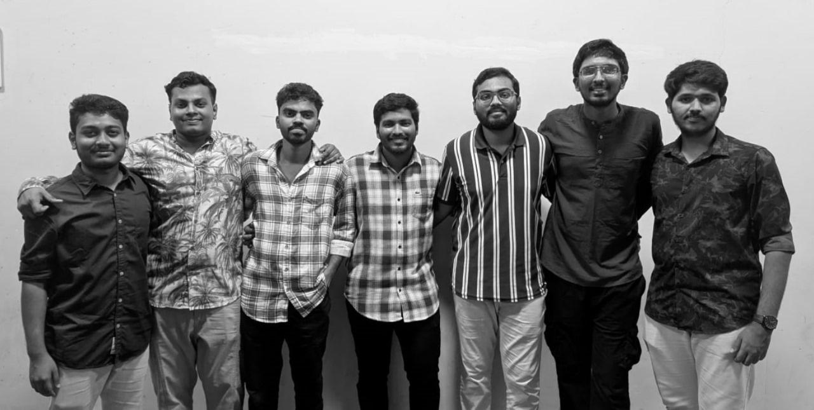
Processing On Input Image
1. Original Image:
This is the raw input image captured from the camera. It contains full color information (RGB) and serves as the baseline for all further processing steps. No filtering or transformation has been applied yet
2. Gray-scaled Image:
The image is converted from RGB to grayscale by removing color information and keeping only intensity values. This reduces computational complexity and highlights structural features needed for processing tasks. Grayscale is widely used in preprocessing because it simplifies operations like edge detection and segmentation.

Slide 5
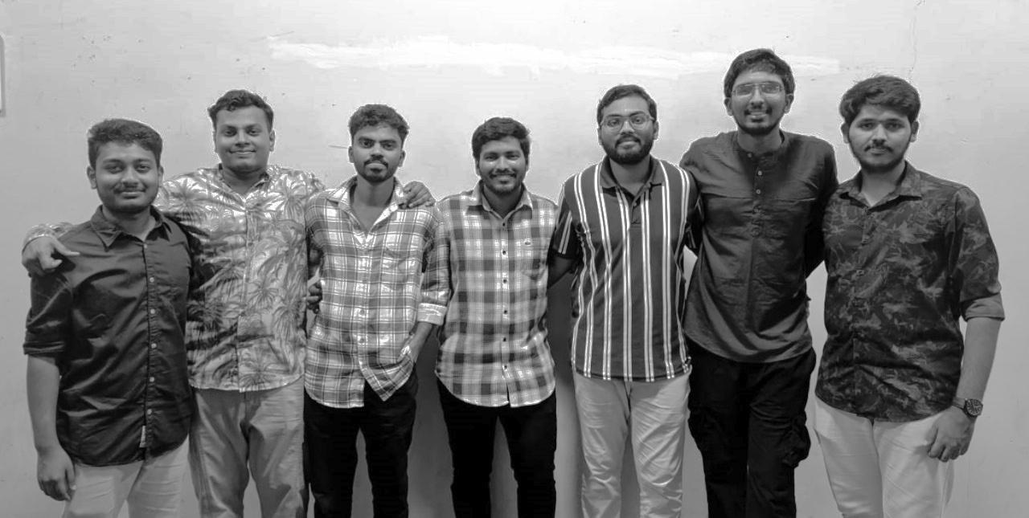

Processing On Input Image
3. Histogram Equalized Image:
The histogram displays the distribution of pixel intensities in the grayscale image. It helps analyze image contrast, brightness, and dynamic range. Peaks and valleys in the histogram indicate how light or dark significant portions of the image are.
4. Noise-Reduced Image (Gaussian/Median Filter):
Noise reduction is applied to smooth the image and remove unwanted speckles or grain. This improves overall image quality and makes later steps—like edge detection and face recognition—more accurate. Common filters include Gaussian blur, median filtering, or bilateral filtering.

Slide 6
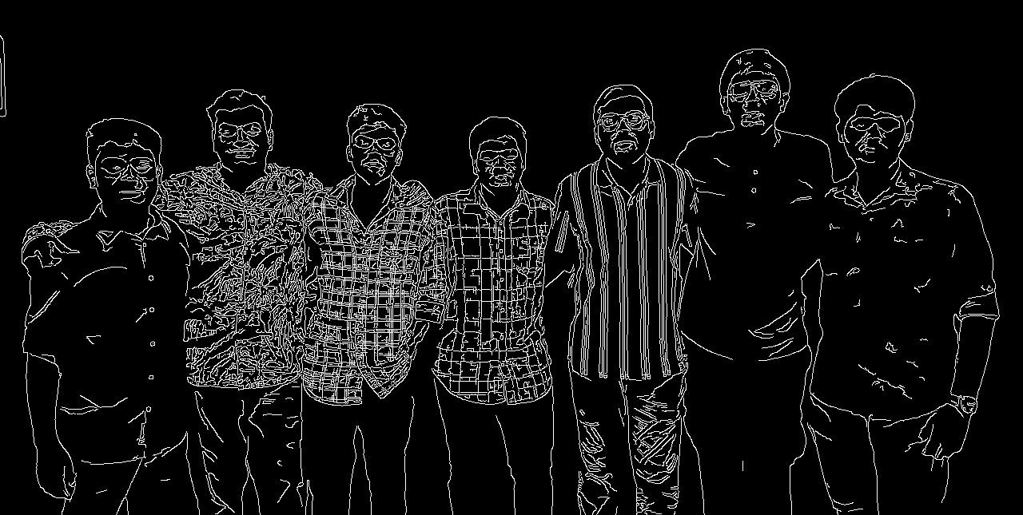

Processing On Input Image
5. Edge-Detected Image:
Edges are extracted using an operator such as Sobel, Prewitt, or Canny. The result highlights boundaries and sharp changes in intensity, helping in segmentation and feature extraction. Edge detection simplifies identifying shapes and important regions.
6. Histogram-Equalized Image:
Histogram equalization adjusts the intensity distribution to enhance contrast in low-light or low-contrast images. This makes facial features or important details more visible and improves recognition accuracy.

Slide 7
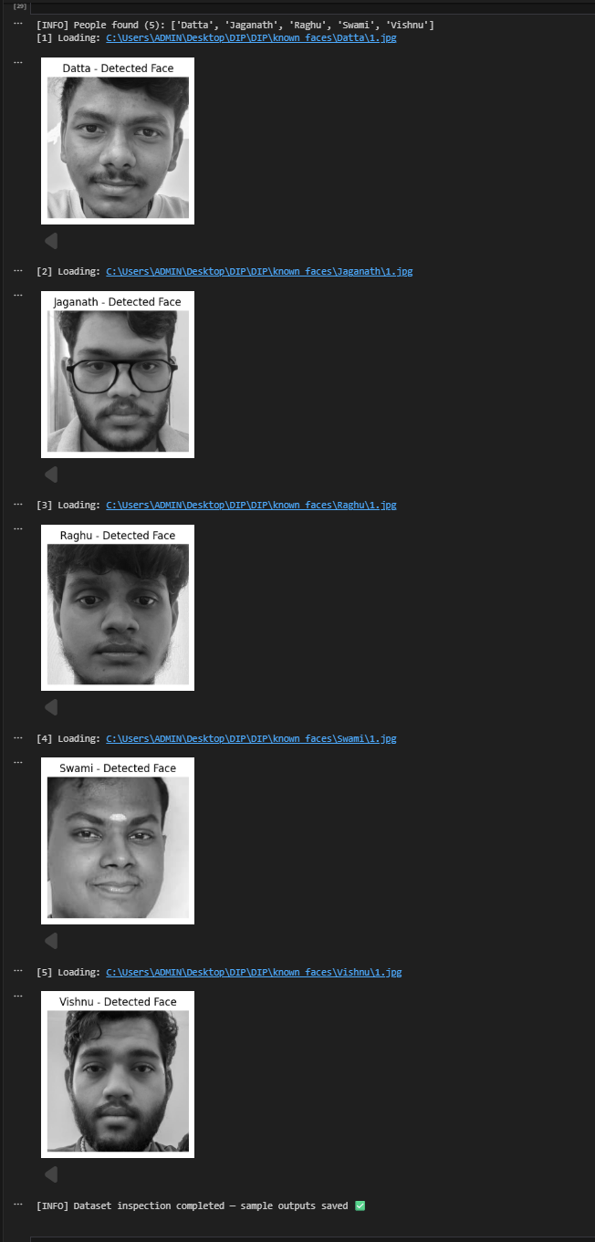
Detecting and Modeling Faces of Dataset

Slide 8
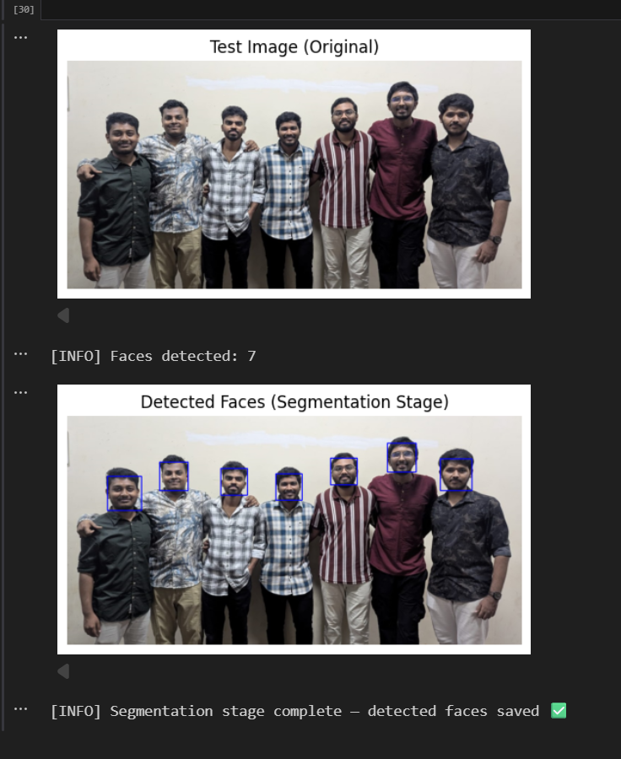
Detecting Faces of Given Image

Slide 9
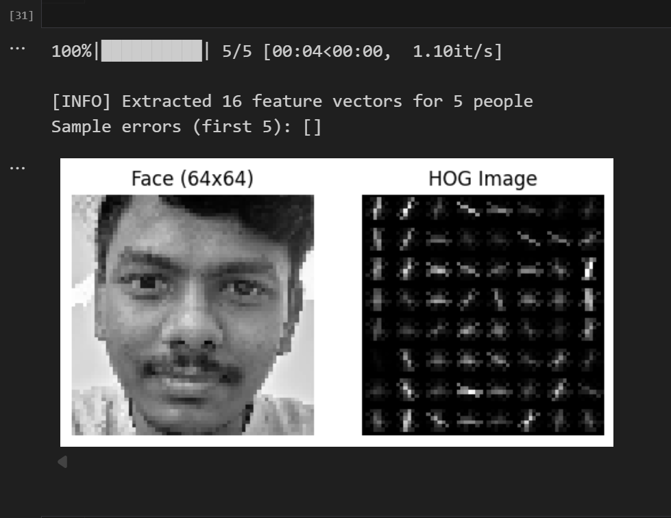
HOG Features for Known Faces:

Slide 10
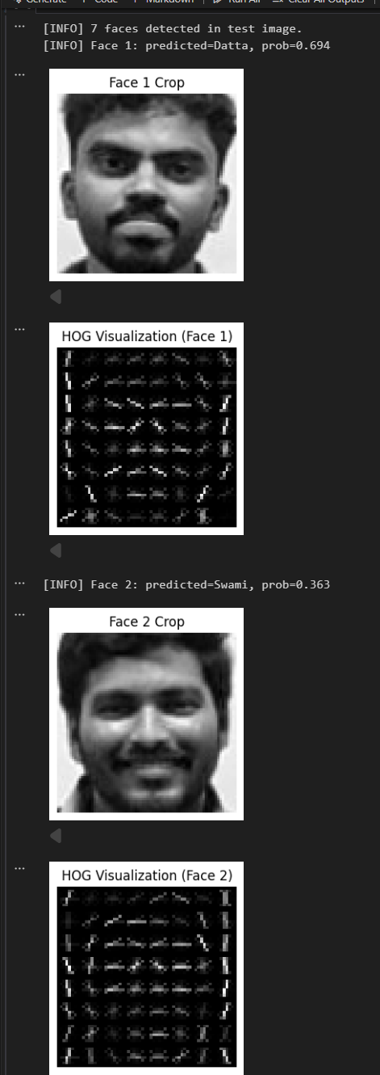
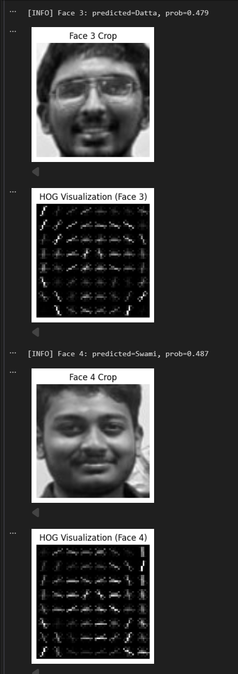
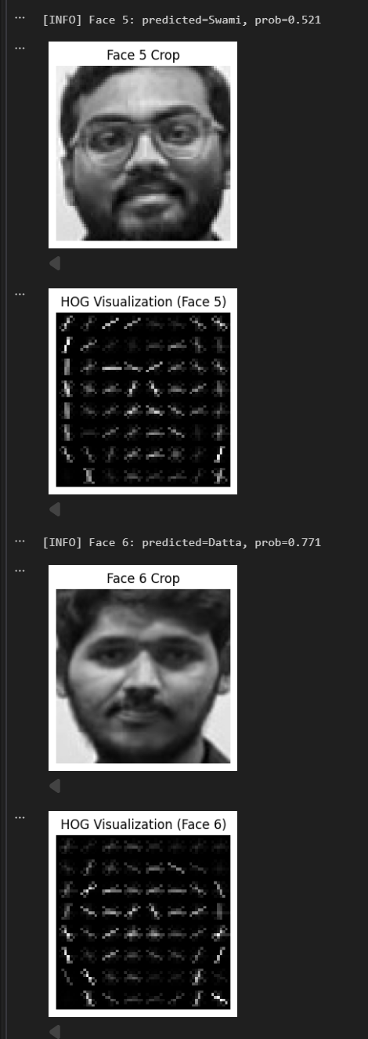
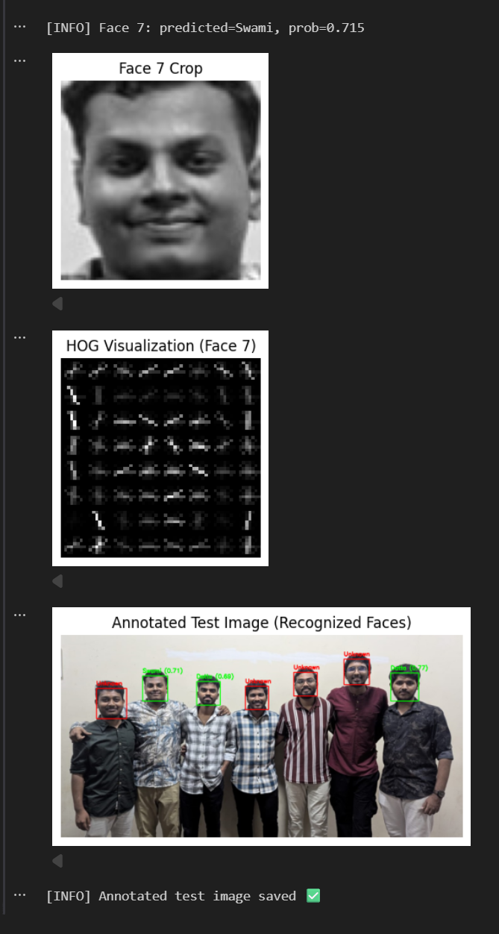
HOG Features for Input Image Faces:

Slide 11










Original Images to Gray Scale Images of Know faces

Slide 12
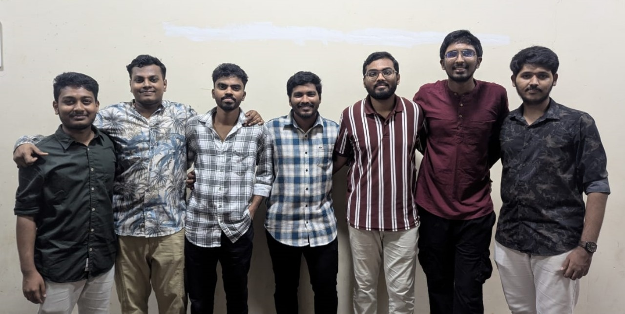

Original Images to Gray Scale Images of Unknow faces and Know faces

Slide 13
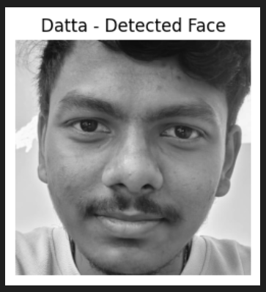
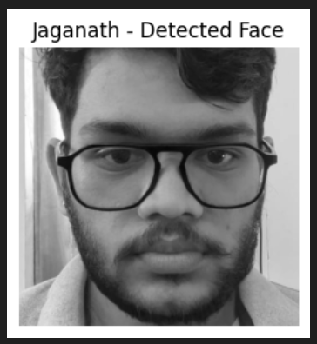
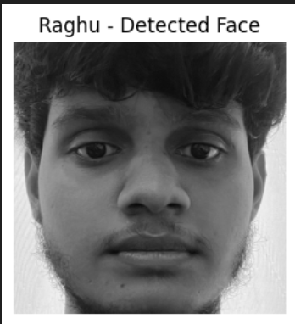
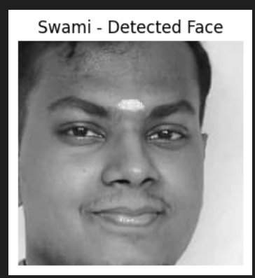
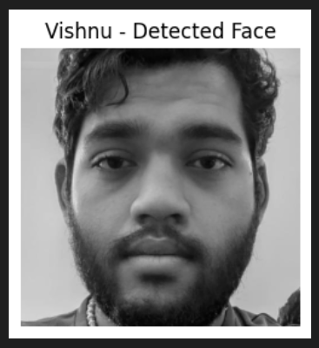
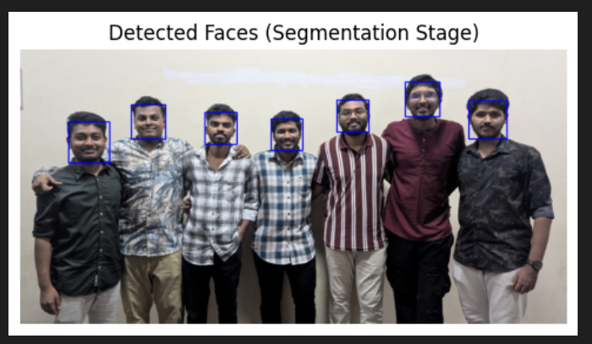
Face Detection

Slide 14
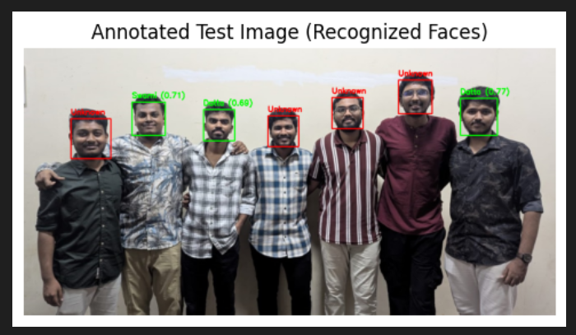
Face Recognition on Test (Input) Image

Slide 15
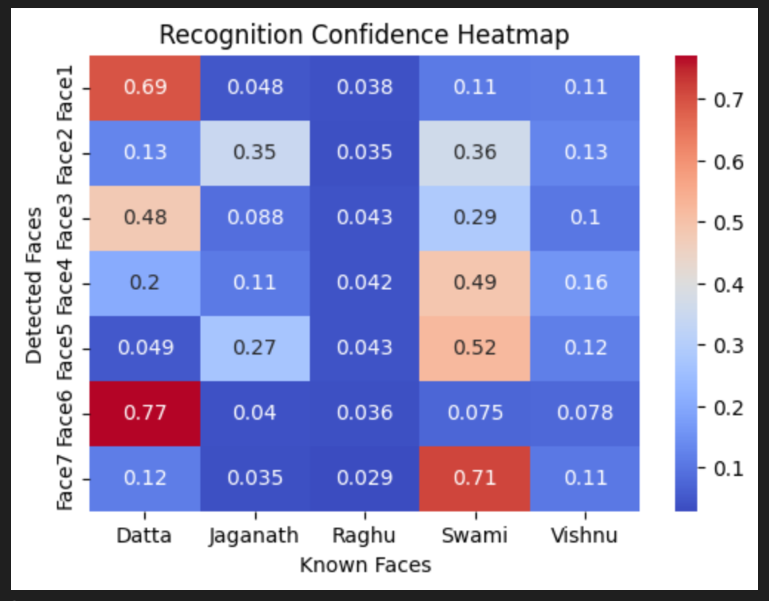
Recognition Confidence Heatmap

Slide 16
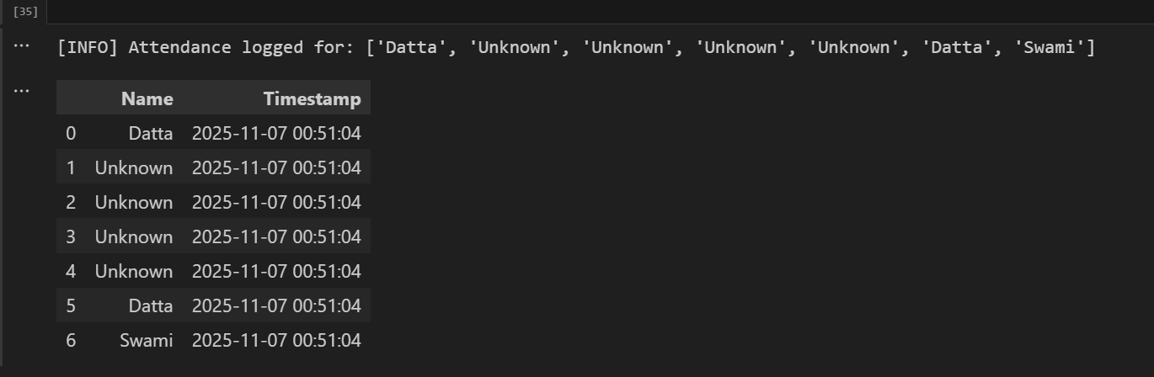
Stored the Attendance of the Faces Recognized

Slide 17
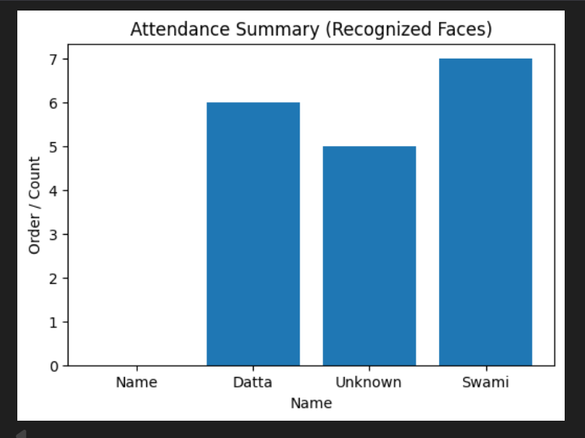
Recognition Confidence Heatmap

Slide 18
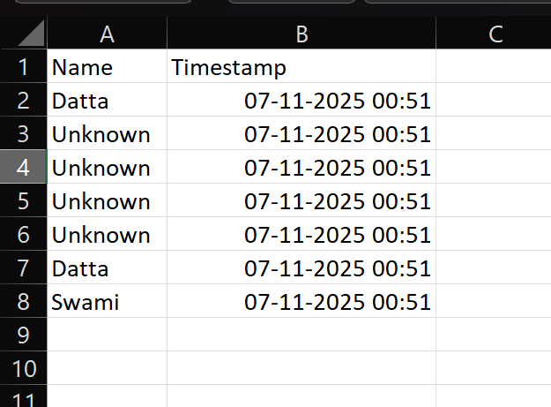
attendance.csv File created on Recognition of Faces

